Slide 1



MEDI
TRACK
Segurança Informática em Redes e Sistemas
Francisco Gil Mata 99221
Luís Marques 110859
Marta Félix 99276

Slide 2
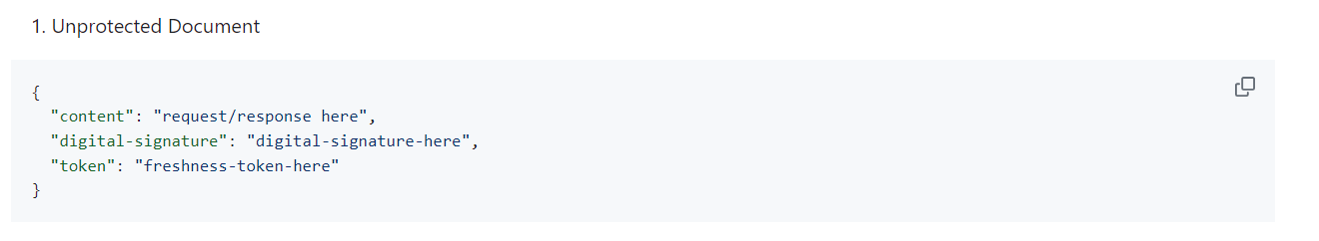
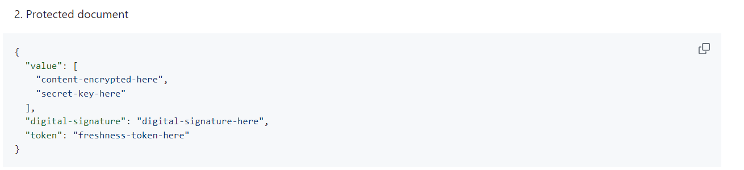
SECURE DOCUMENTS
Implemented using Java,
From the Java Cryptography Architecture (JCA)
Two versions
Encryption using a hybrid mode
Digital Signature and Freshness token

Slide 3
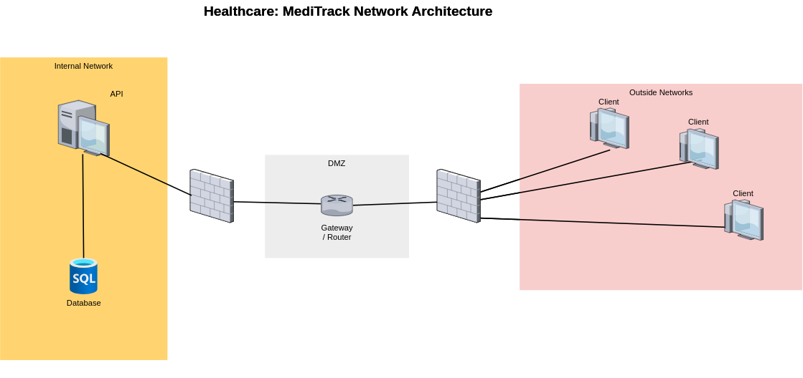
INFRASTRUCTURE
The infrastructure contains 4 VMs, each with its own configurations and firewall rules.

Slide 4





INFRASTRUTURE
WebSockets
Used SQLite for the database
Does not support encryption-at-rest
Comunication using secure WebSockets
Query
Database
(SQLite)
Response
Server / API

Slide 5



CHALLENGE RESPONSE
Hi, I’m Bob!
Prove it to me!
Client

Slide 6
SECURE CHANNELS
Database
API
API
Client
Secure Sockets
Internal network
Assuming its security negates the need for data encryption
HTTPS
API as the communication server
Secure Documents library for encryption

Slide 7
KEY DISTRIBUITION
Hybrid process
Simplified key pairs
Using an asymmetric cipher to encode the secret key for content encryption.
For the clients to simulate acess.
Value fields encrypted
Authentication
With a secret key using the "AES" cipher
Required before every operation. In a real scenario, users would have logins and sessions

Slide 8

SECURITY CHALLENGE
“SOS” Mode
Only Doctors can activate the SOS Mode
Allows the Doctor access to a patient records
Active for 2 minutes
Requires Reauthetication

Slide 9

IN CONCLUSION
Achieve our primary goal
Establish secure connections between the database, API, and clients
Data Encryption
A real-world scenarios would demand more sophisticated system

